Slide 1

Group-L
James Hunt, Joseph Kilbane, Reece Davies & Struan Sharpe

Slide 2
ConnectedRail is an interconnected system for the use of trainlines around England (but at the moment local) for both the staff and passengers amongst train journeys.
ConnectedRail Keeps a simplistic design desiring modals and popups over redirecting the user to separate pages, with a consistent design and theme in mind
With a RESTful API
Secure features to keep end user safe

Slide 3
Consists of a Java Application for the staff so they can know which shifts they are working and information around it, such as what location they are starting in, which has larger buttons with bold text for touch screen users in mind
A PHP web application for the Administrator so they can maintain the information within the database for staff, trains, carriages and train journeys, with featured modal pop up design to keep user grounded.
A Xamarin mobile application which is for the use of passengers of the train, where they are able to search for trains and look through their own personal tickets.

Slide 4


Administrator Application
Developed by James Hunt

Slide 5
Summary of application
Allows the admin to perform routine tasks.
These tasks include the data maintenance of all data within the database.
Allows admin to view passengers and staff members.
Allows admin to view bookings made by passengers.
Securely implemented with sessions, SHA256 encryption and salting.

Slide 6
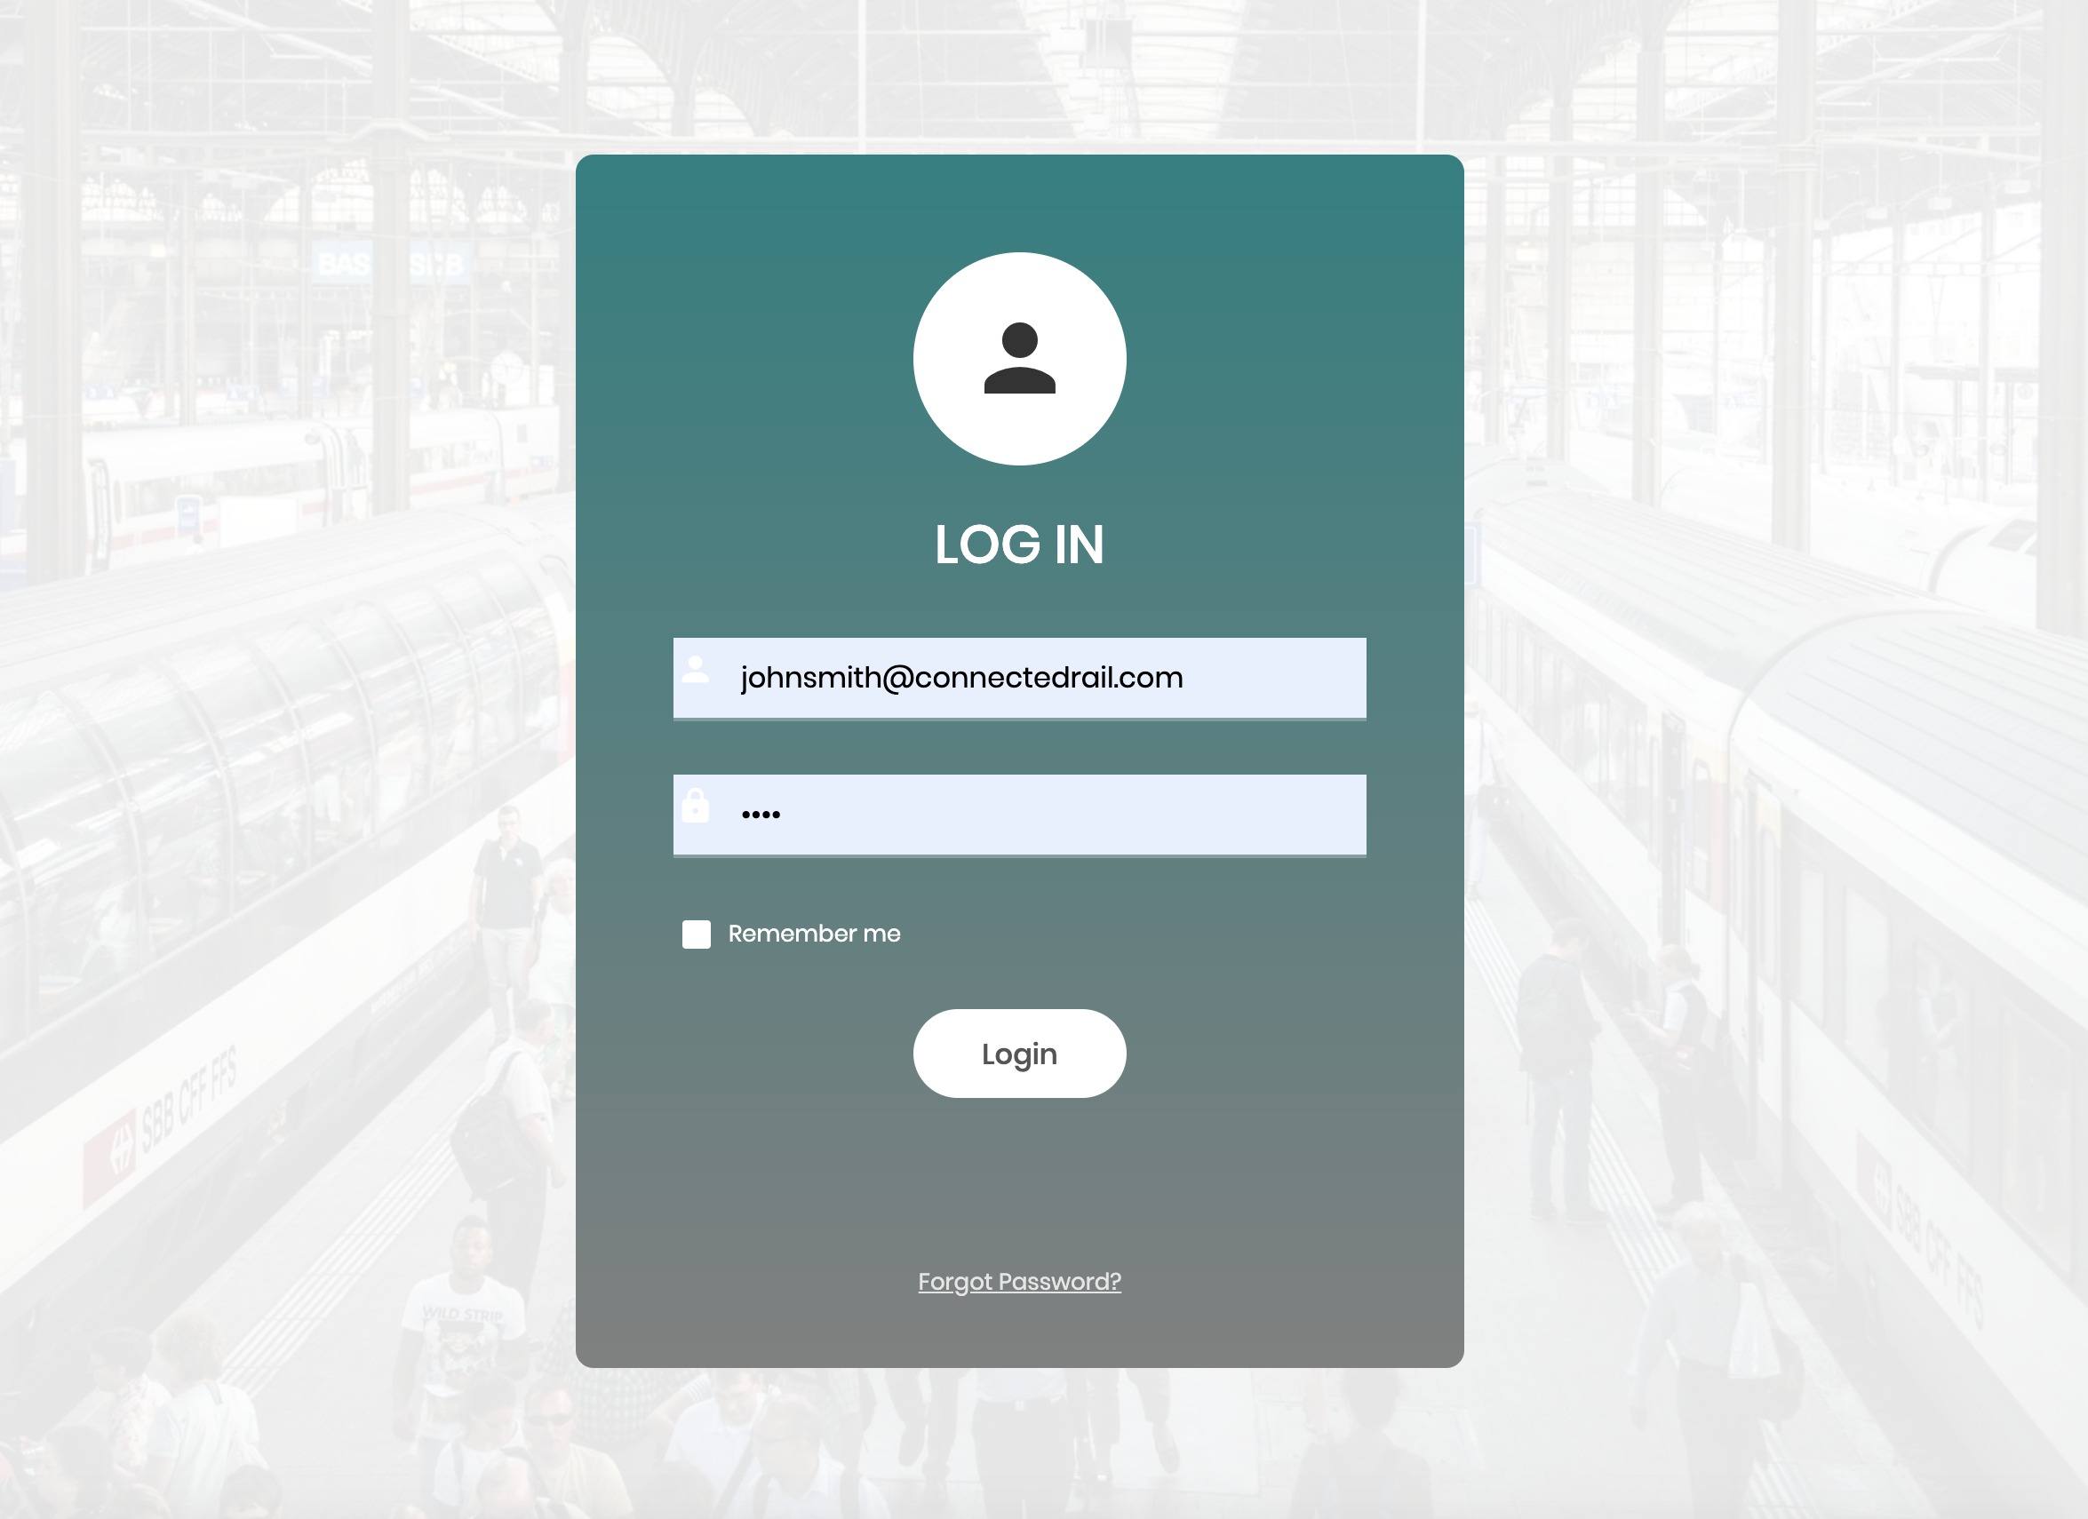
Login

Slide 7
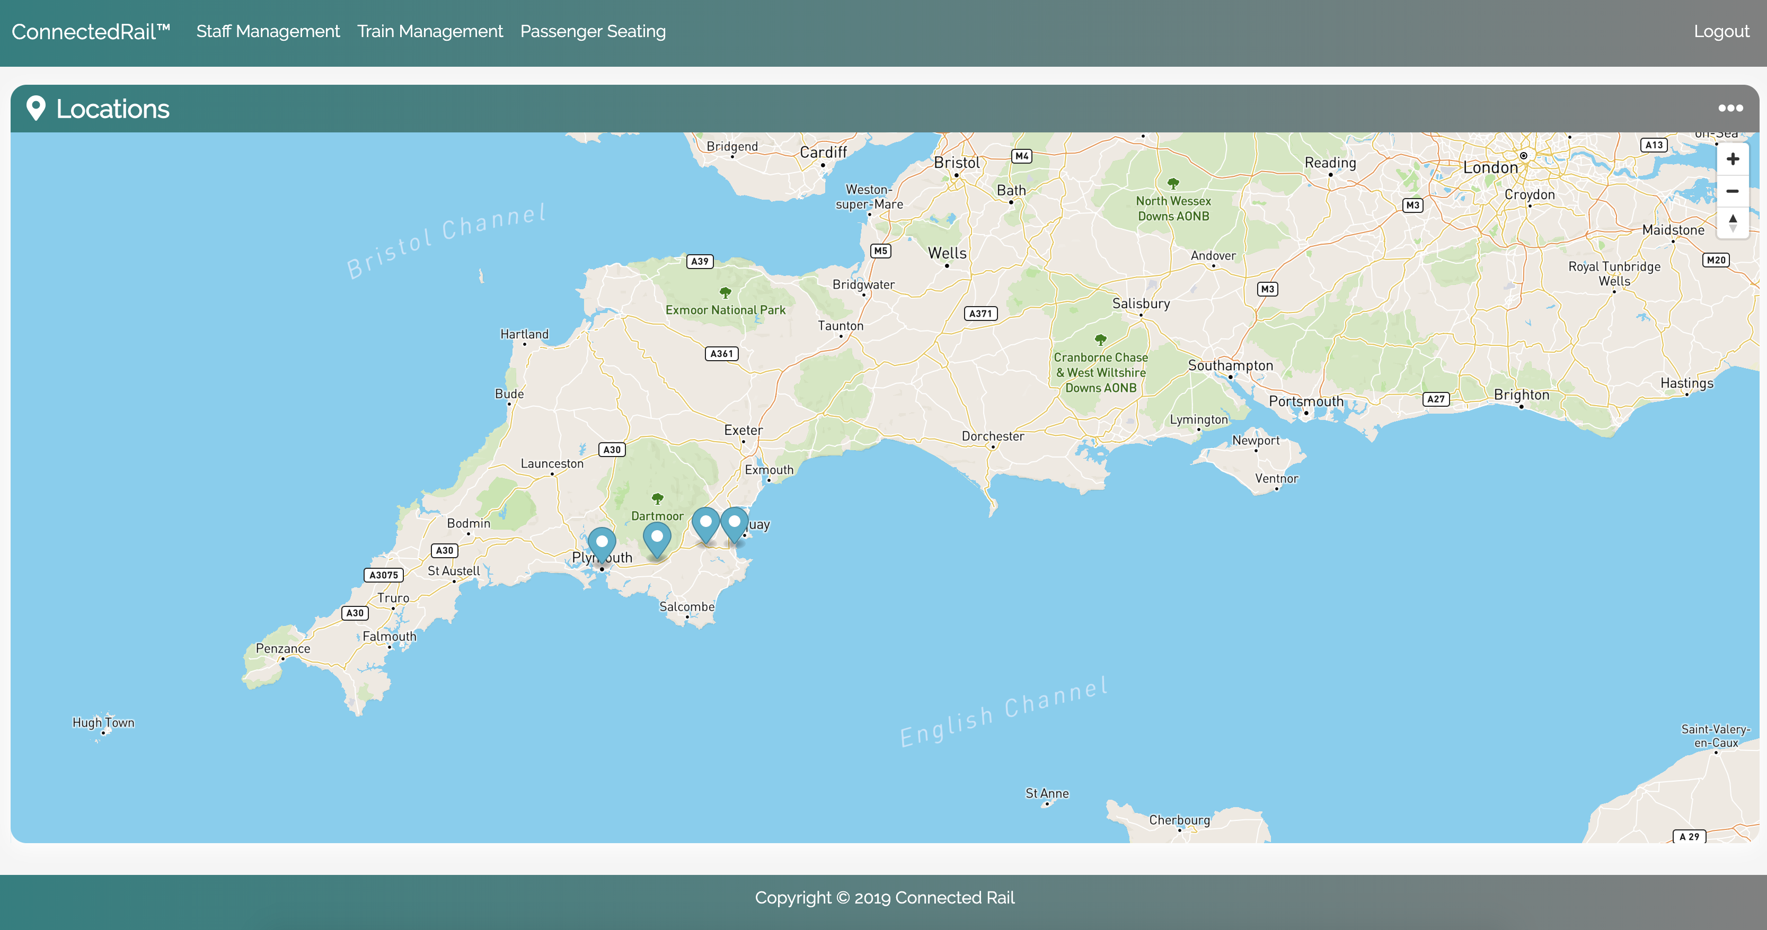
Home page – Locations Summary

Slide 8
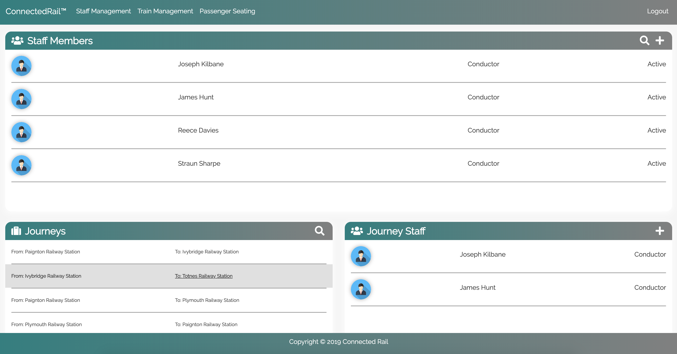
Summary of staff & journey staff

Slide 9
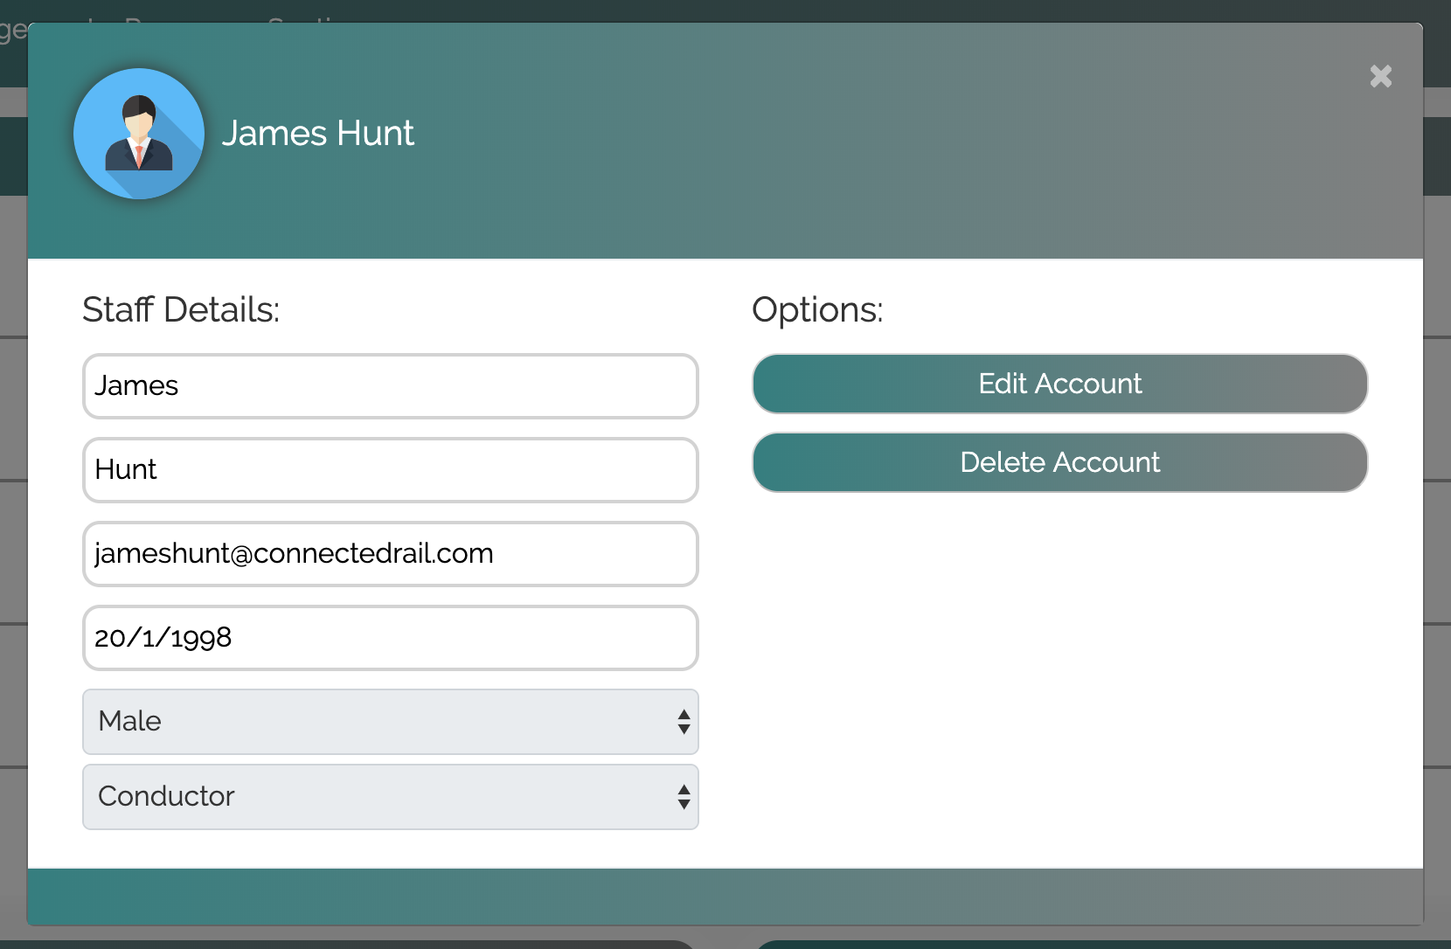
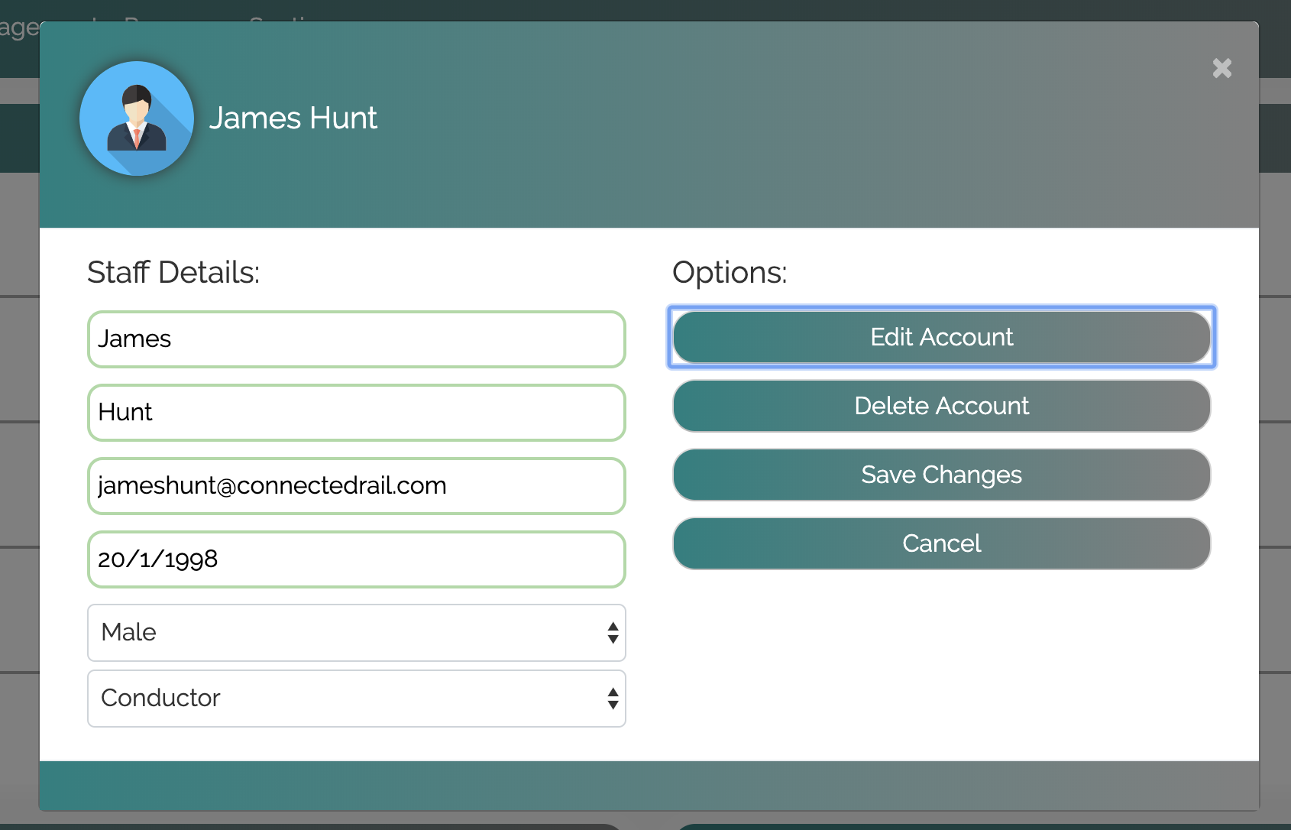
Updating staff data

Slide 10
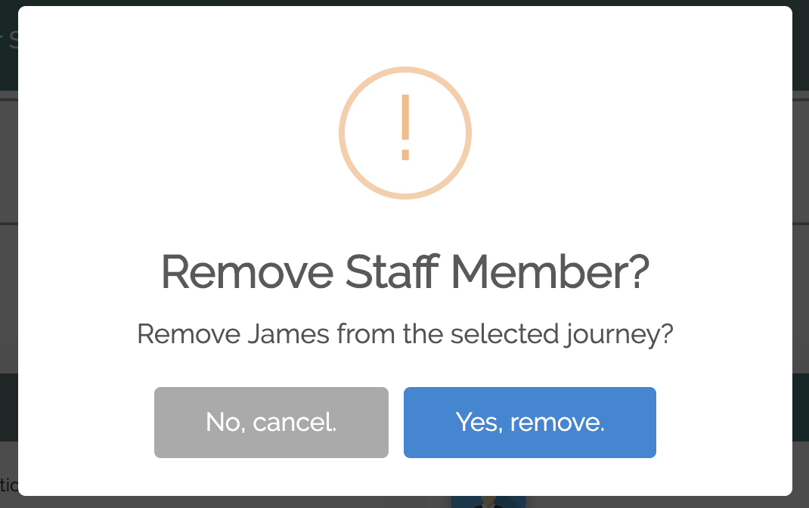
HCI – Alerts and Easy Reversal of Actions

Slide 11
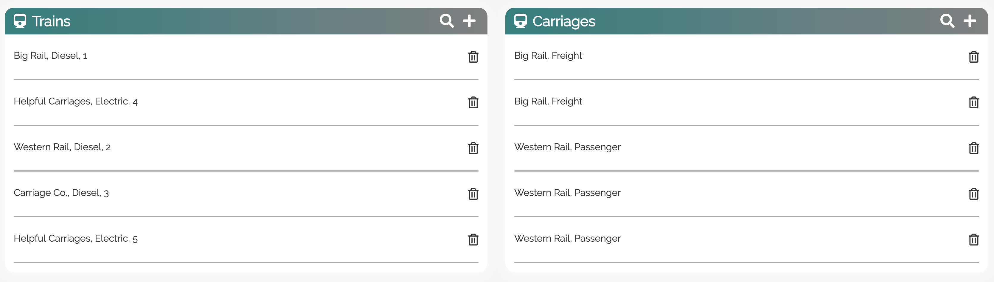
Train Management

Slide 12
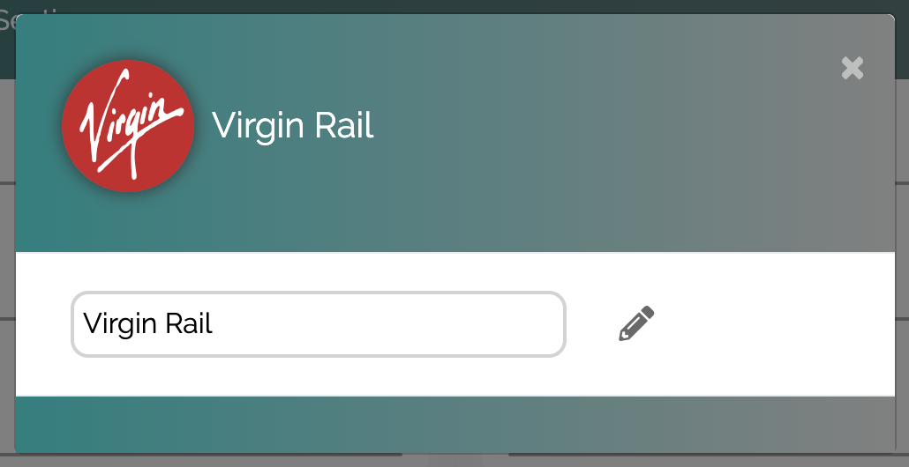
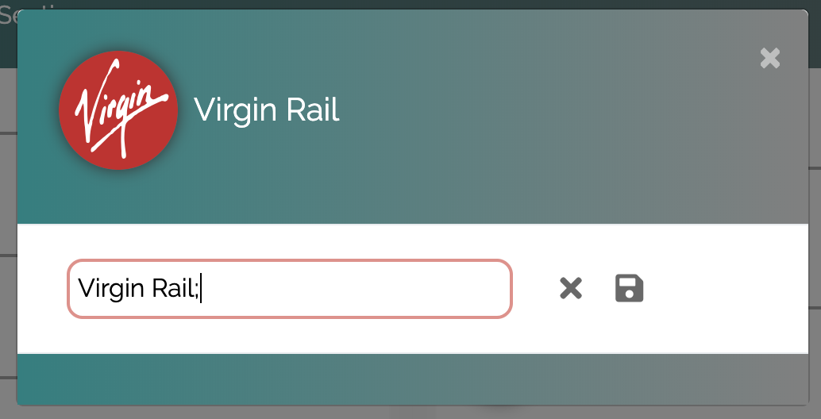
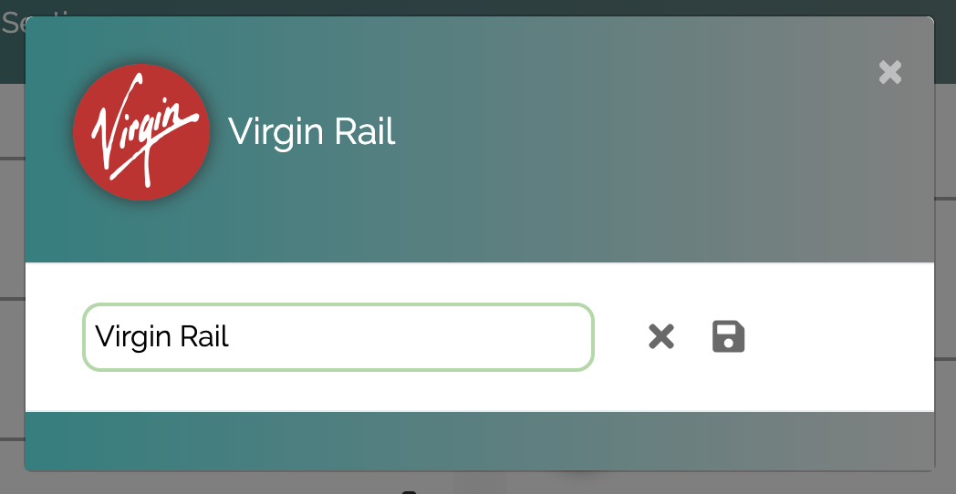
Client Side Validation & Protection

Slide 13
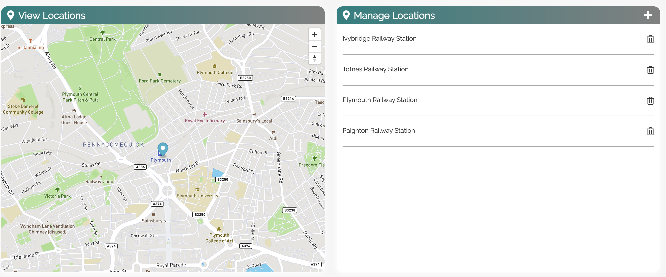
Location Management

Slide 14
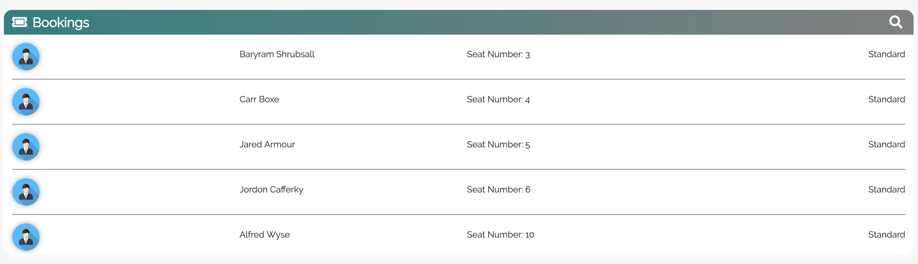
Booking & Passenger Management

Slide 15
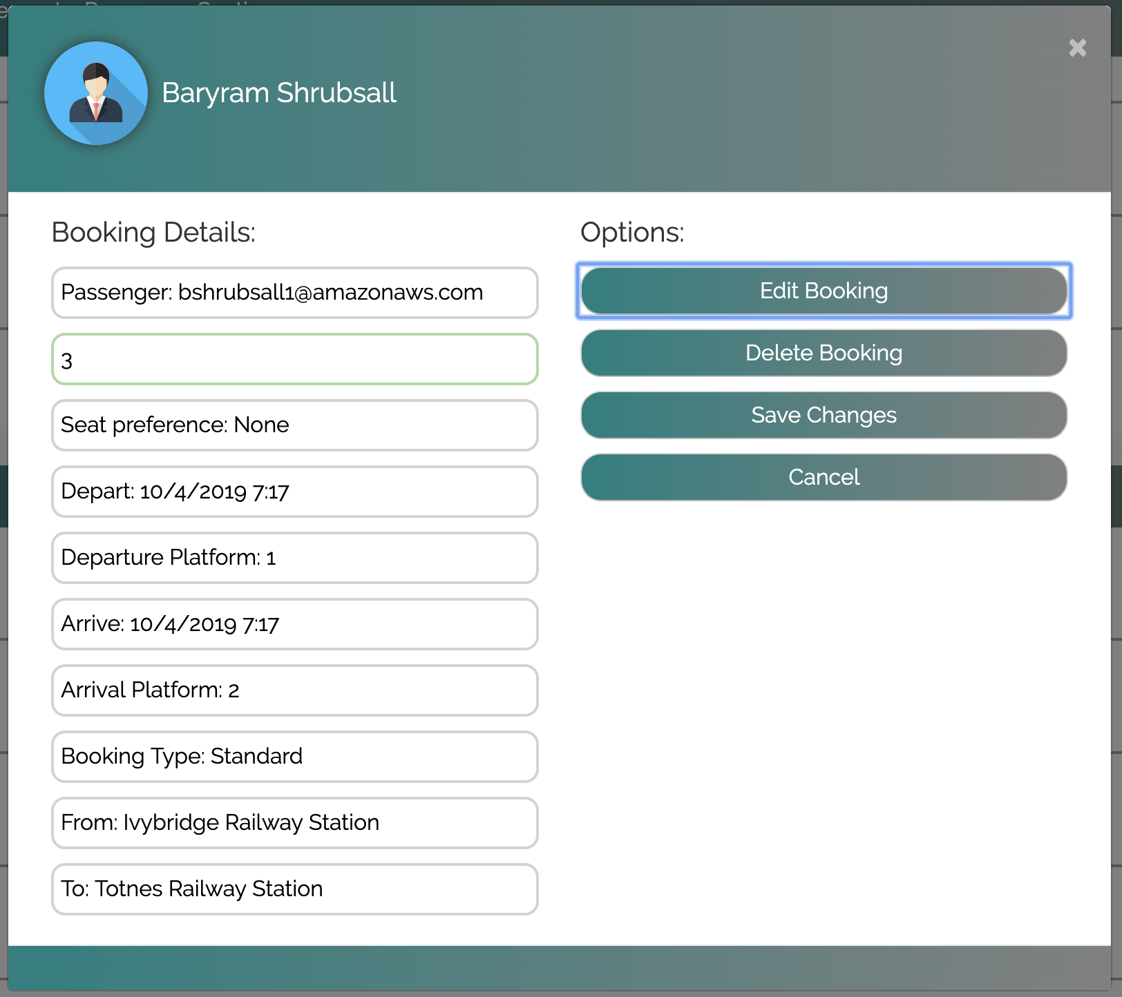
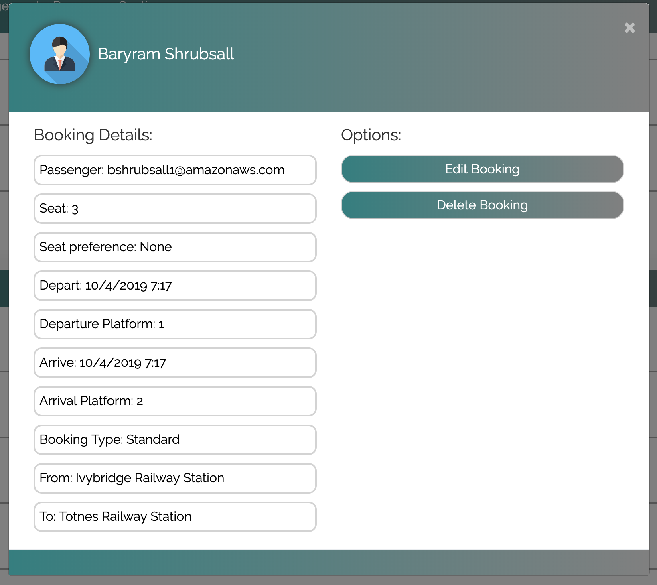
Updating Passenger Seats

Slide 16
Staff Application
Developed By Joseph Kilbane

Slide 17
User Stories and key areas for the application
As a staff member I would like to view all journeys.
As a staff member I would like to see additional information for journeys (bookings and platform information).
As a staff member I would like to view my personal shifts.
As a staff member I would like to edit my profile.
If I have the default password, I would like to be told to change it.
As a staff member I would like to sort the tables to view a specific shift or journey.

Slide 18

Staff application- technical details
Model-View-Controller based application
Secure Login
Multiple Threads for auto-updating
Touch screen suitable layout
Professional look and feel
Unique login
Logout
Junit testing

Slide 19
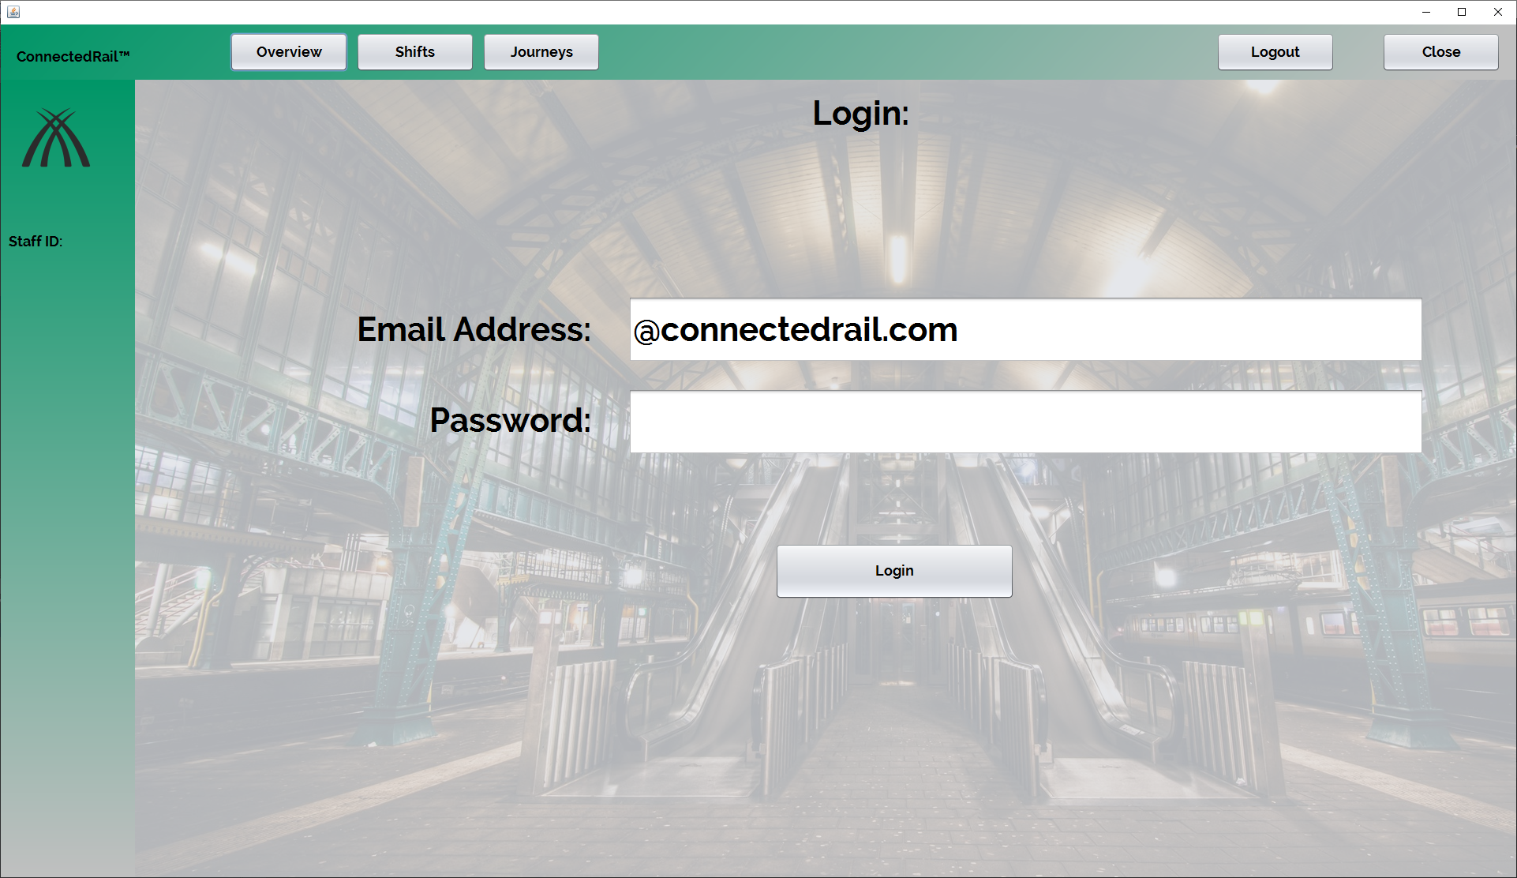
Logging In and General Design
The email address is partially filled just for usability.
The general design is in-keeping with the web.
Large and clear buttons and fonts are used.

Slide 20
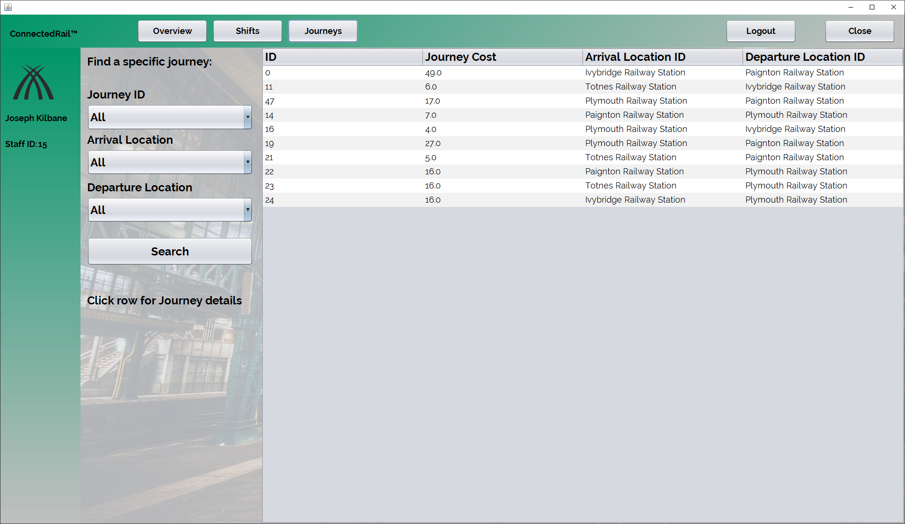
Viewing Journeys
This is the default view for the journey table, from the side you can see that there are several combination boxes, which only show the available options, to sort the tables.

Slide 21
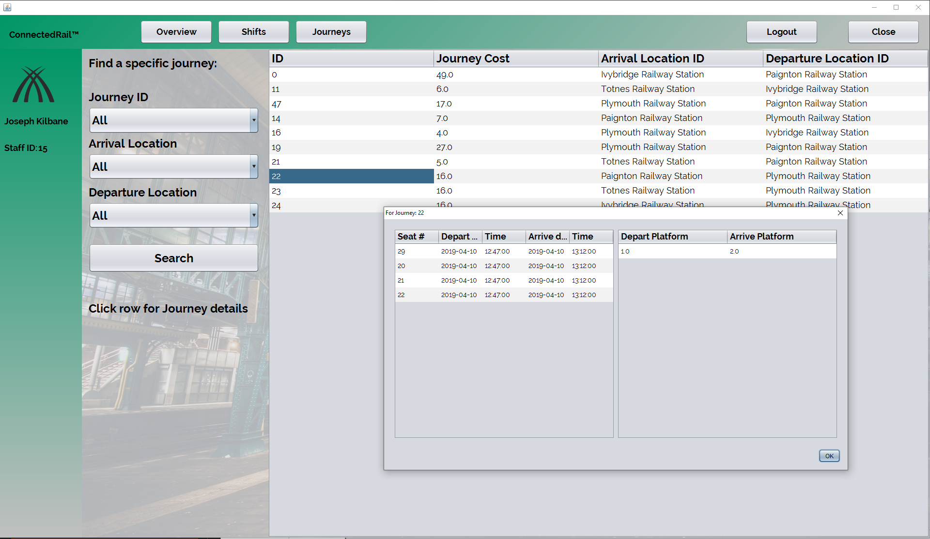
Additional Journey Details
This is the message box that appears when the user clicks a specific row. The row shown is for journey 22, you can see the seats that are booked on the journey with time and date with platform information.

Slide 22
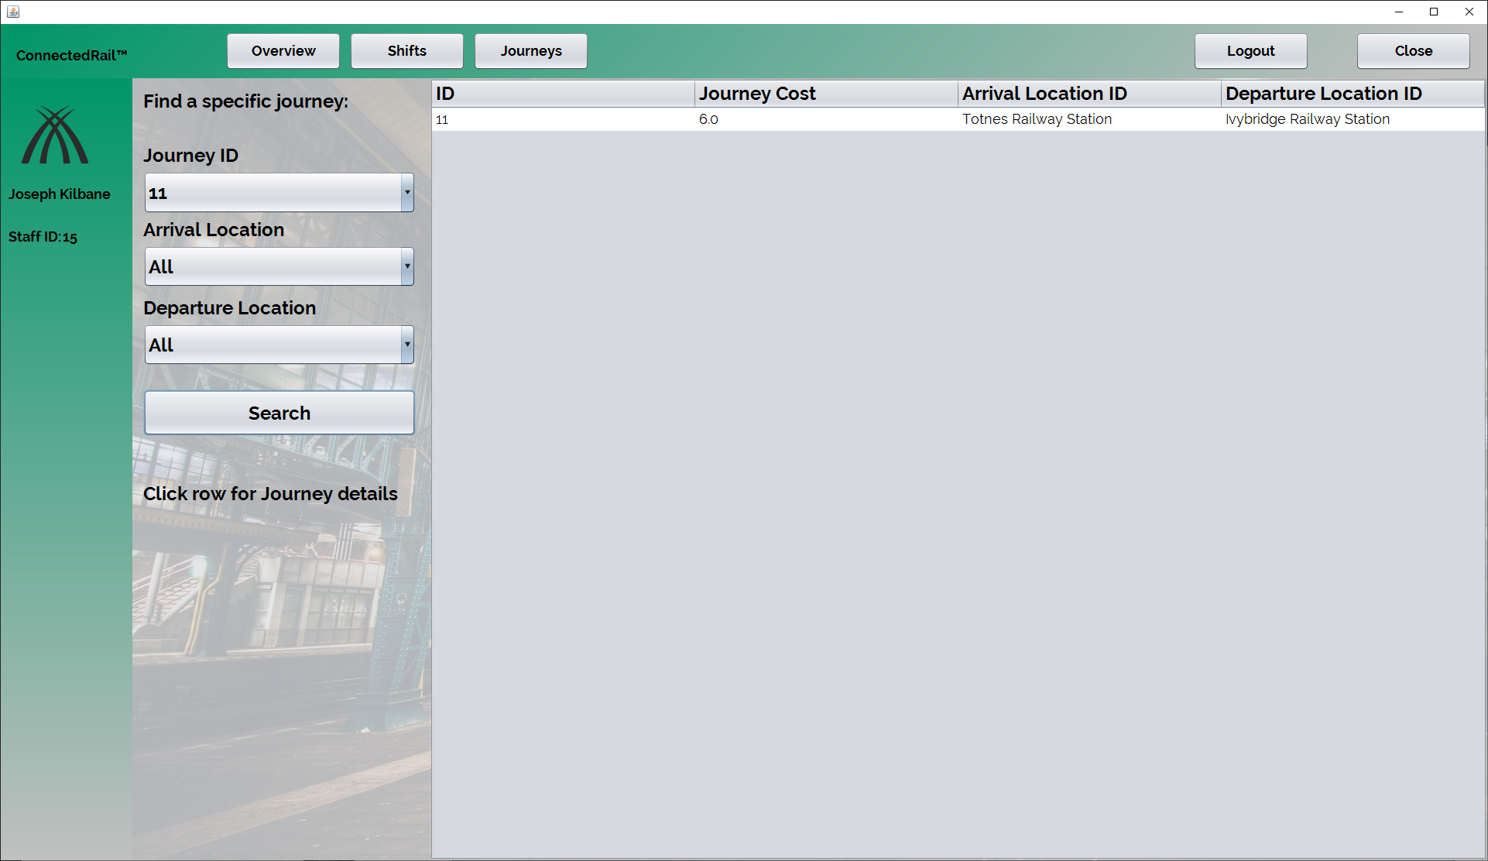
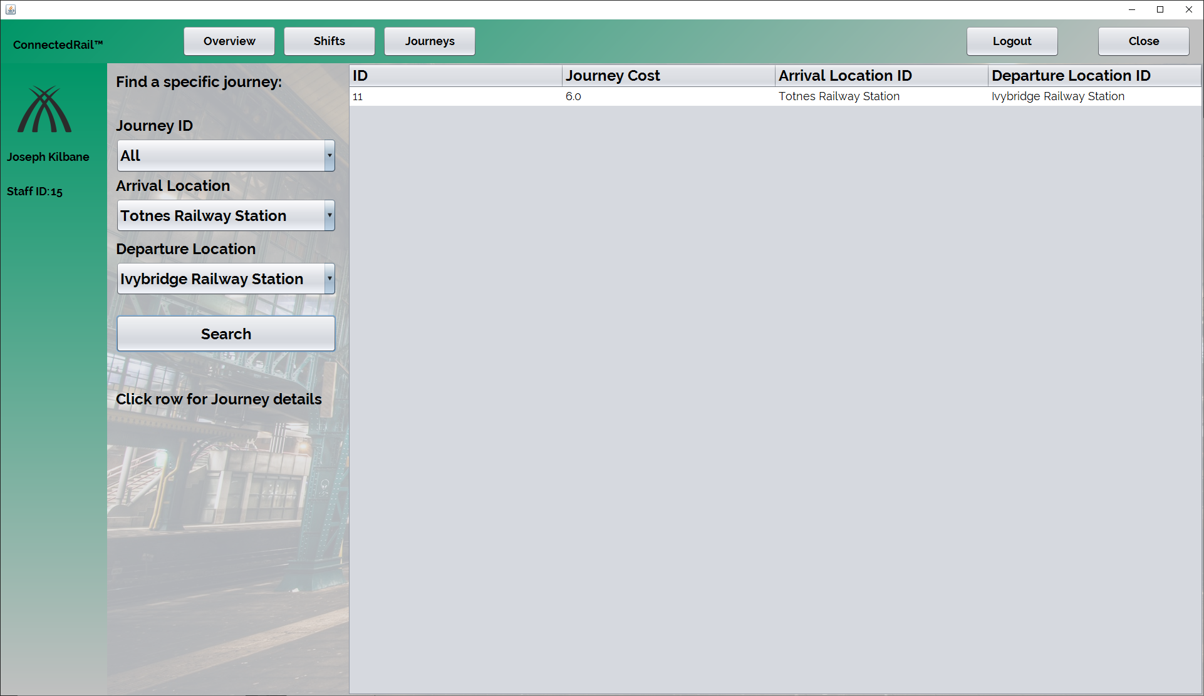
Sorting table
As shown, the combination boxes can be used in unison to find a specific journey is the user is unsure of the journey ID.

Slide 23
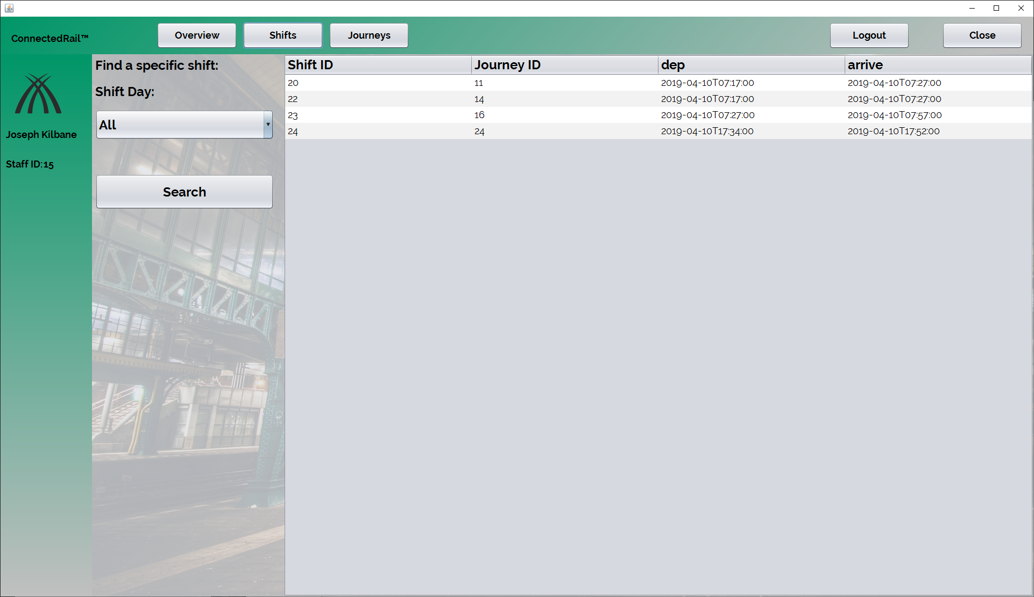
Viewing shifts
This is the shifts table, this table shows the information about what journey the logged in staff member is assigned to.

Slide 24
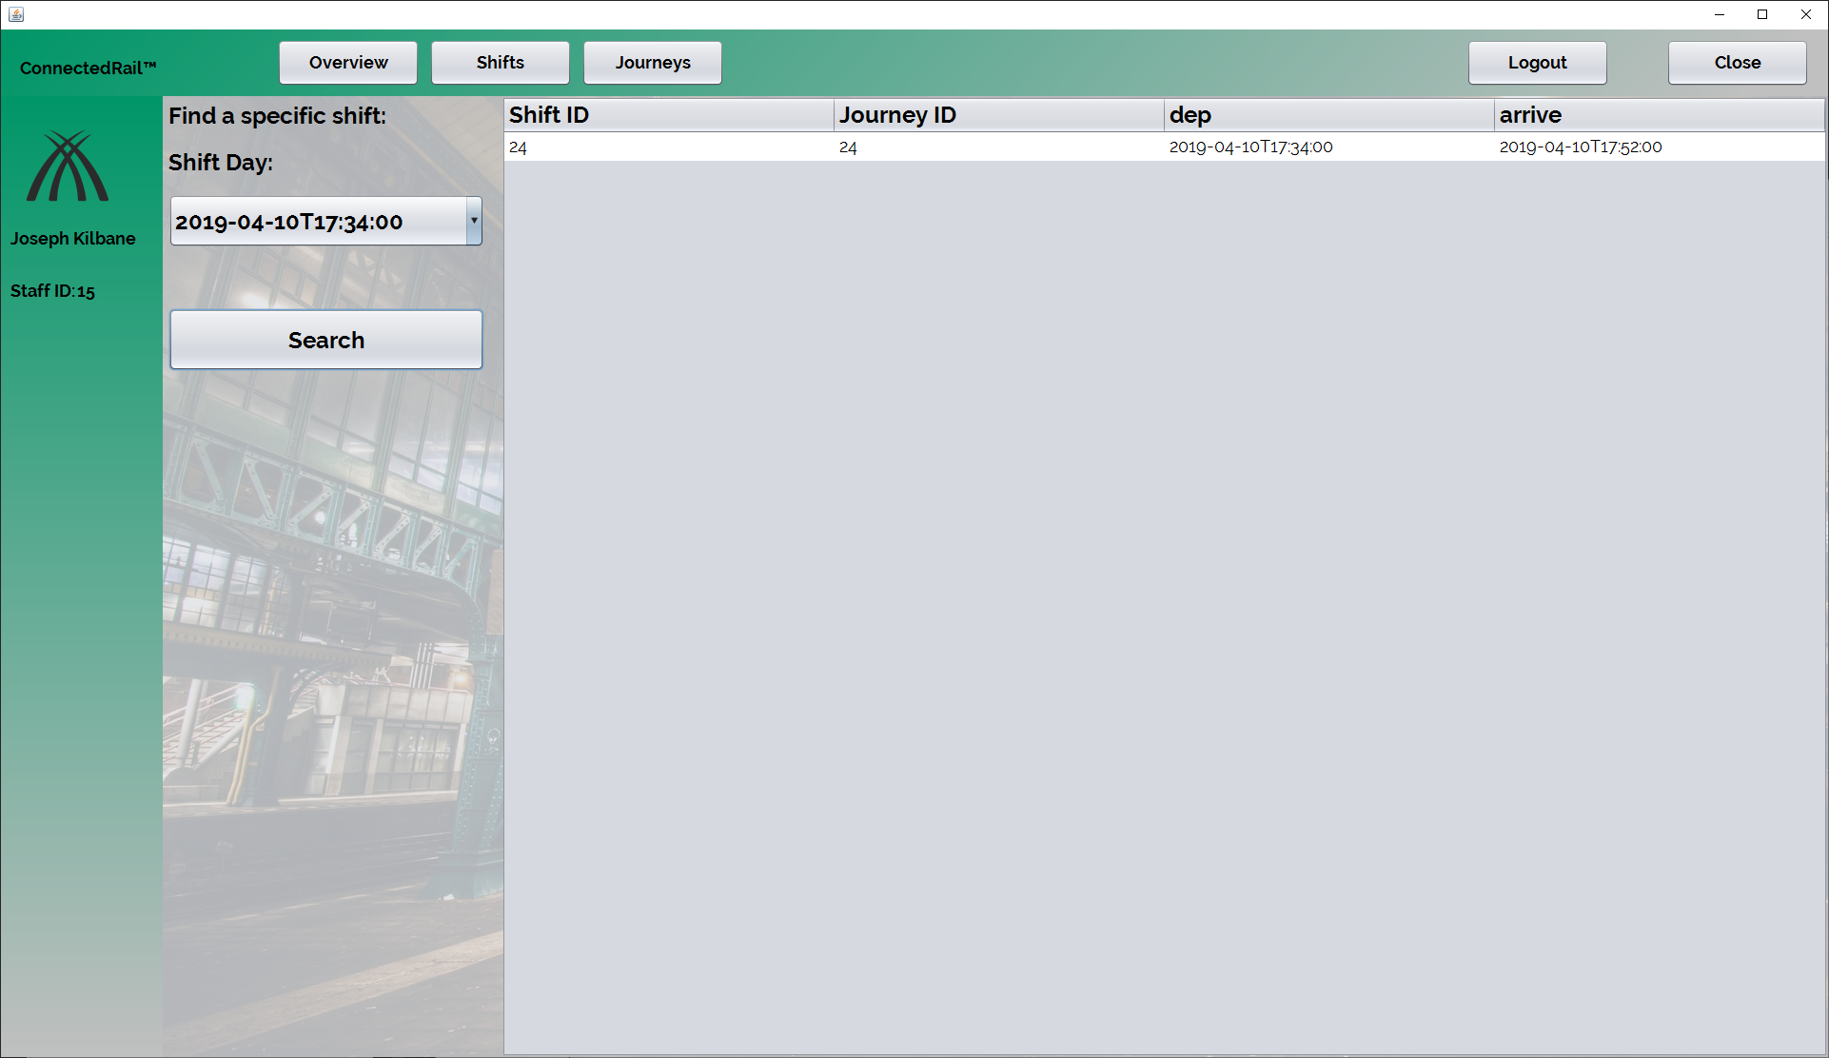
Sorting the table
The drop down menu allows the staff member to view only specific shifts.
The times in the drop down are the departure date/time, e.g. the start time of the shift/trip.

Slide 25
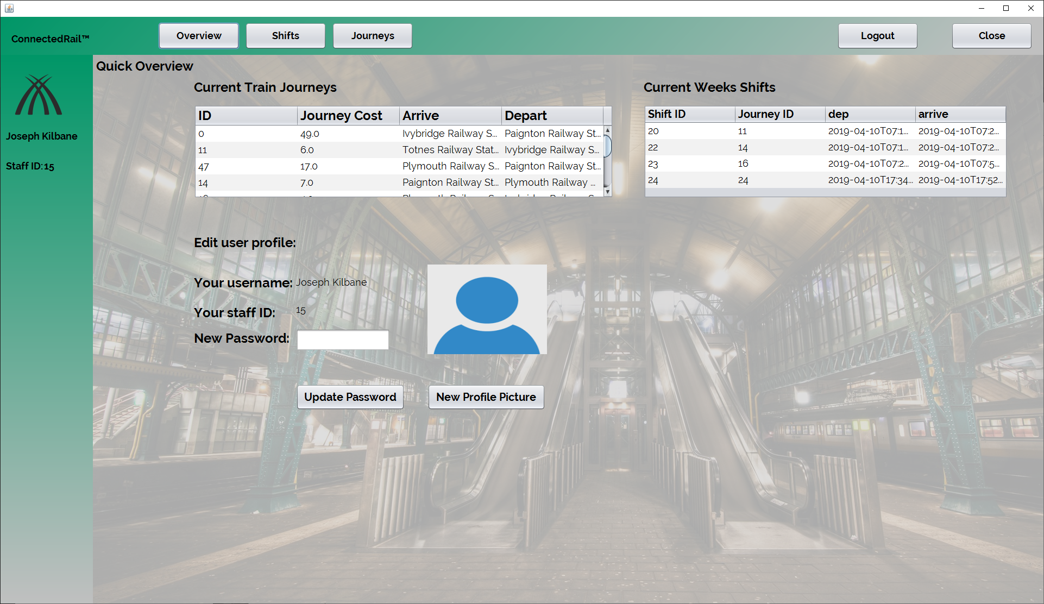
Overview Page
During development, it was decided to have an overview page to allow the user to edit their profile.
Two mini versions of the tables are shown for a ‘quick view’ of the shifts and journeys.

Slide 26
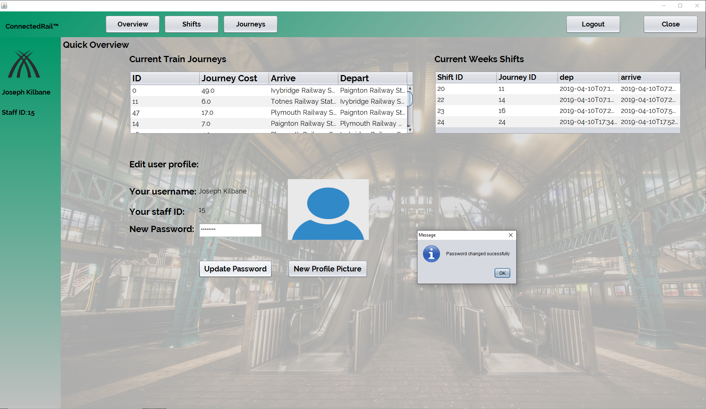
Changing Password
This page also allows the user to change their password, we felt as a team that this should be the only detail they should be able to change.
You are given the shown dialog after clicking update password.

Slide 27
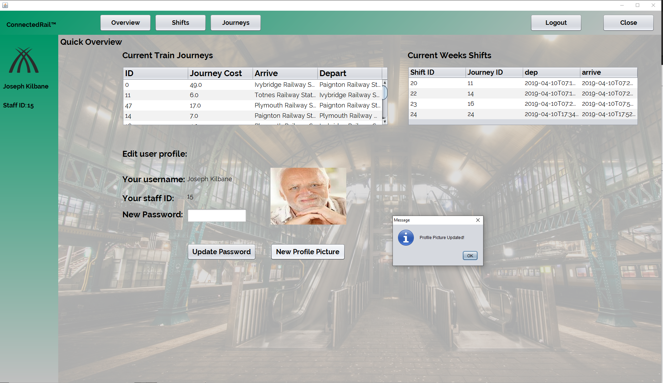
Feature in progress- profile picture
The ability to change your profile picture had to be changed due to development reasons, API issues.
The program currently will only show your new profile picture but not save it.
However there is commented code in the program to convert the image into a BASE64 string and then compress it.

Slide 28
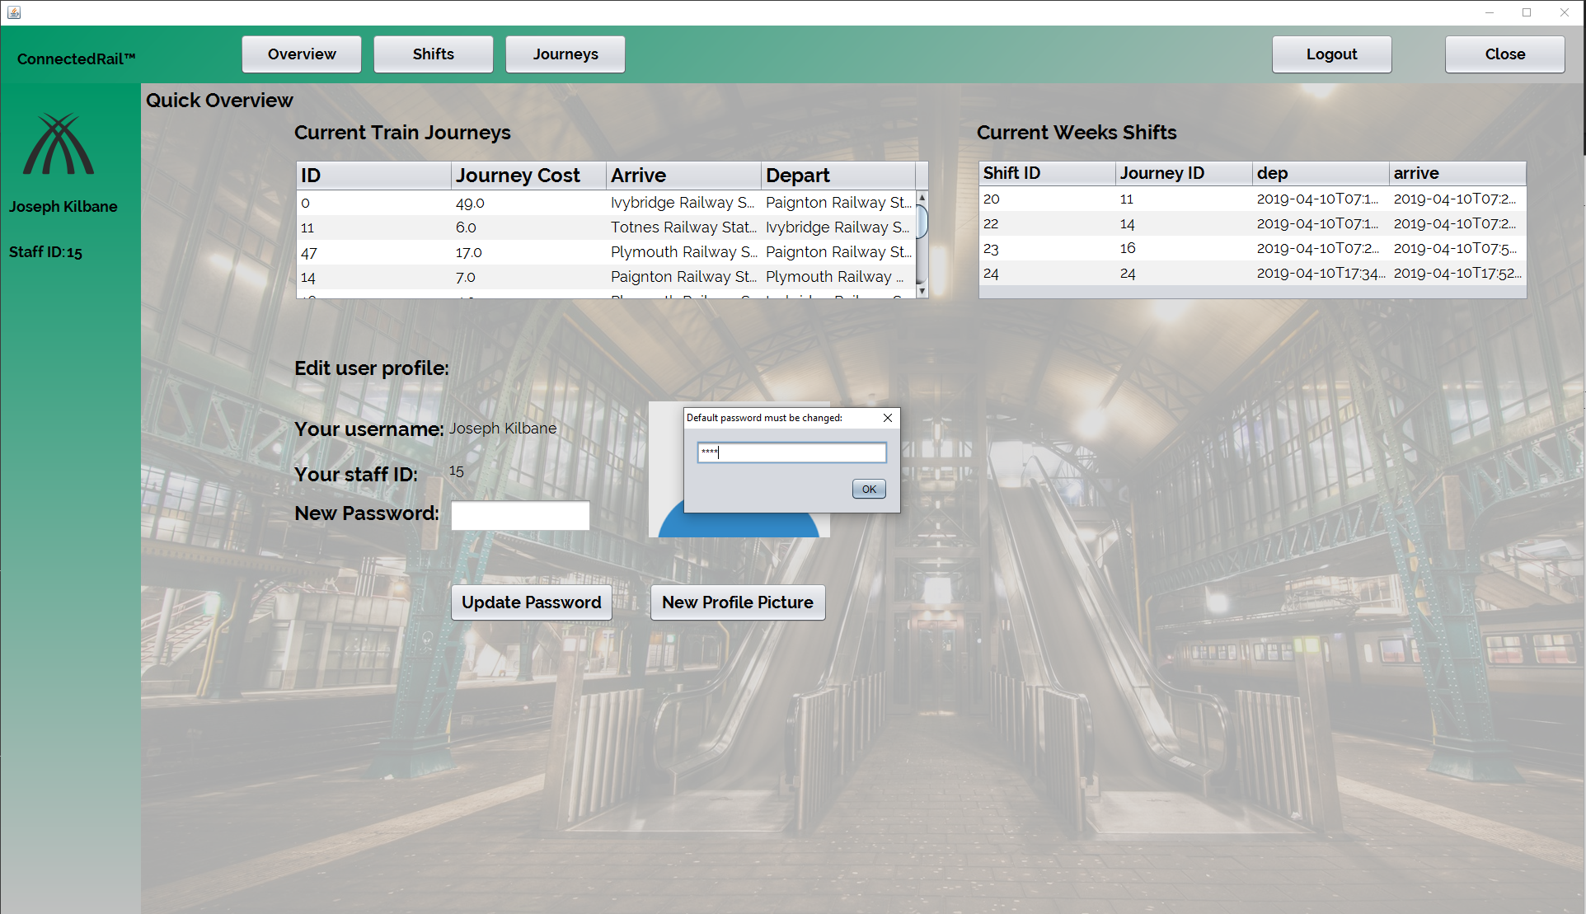
Default Password Change
When the admin creates a staff account, the account is given the default password of ‘password’.
For security reasons we decided to have a prompt to tell the user to change the password.
This appears after logging in immediately.

Slide 29
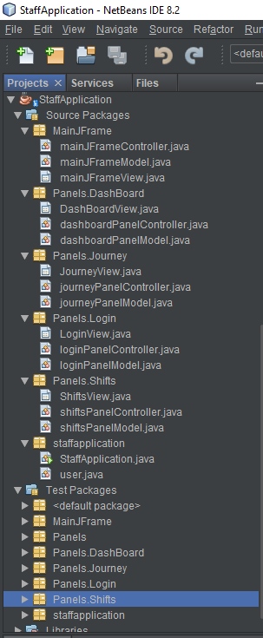
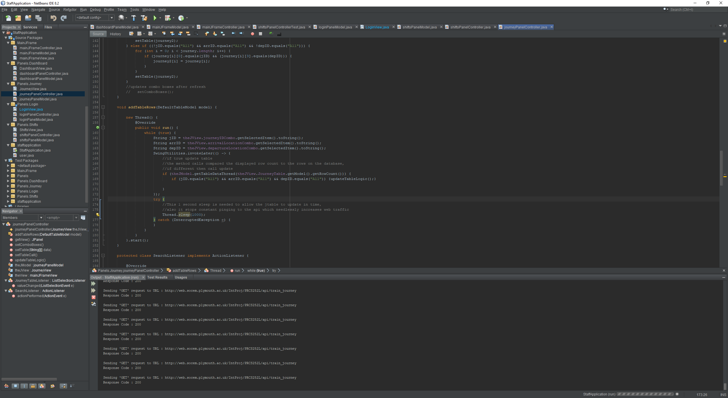
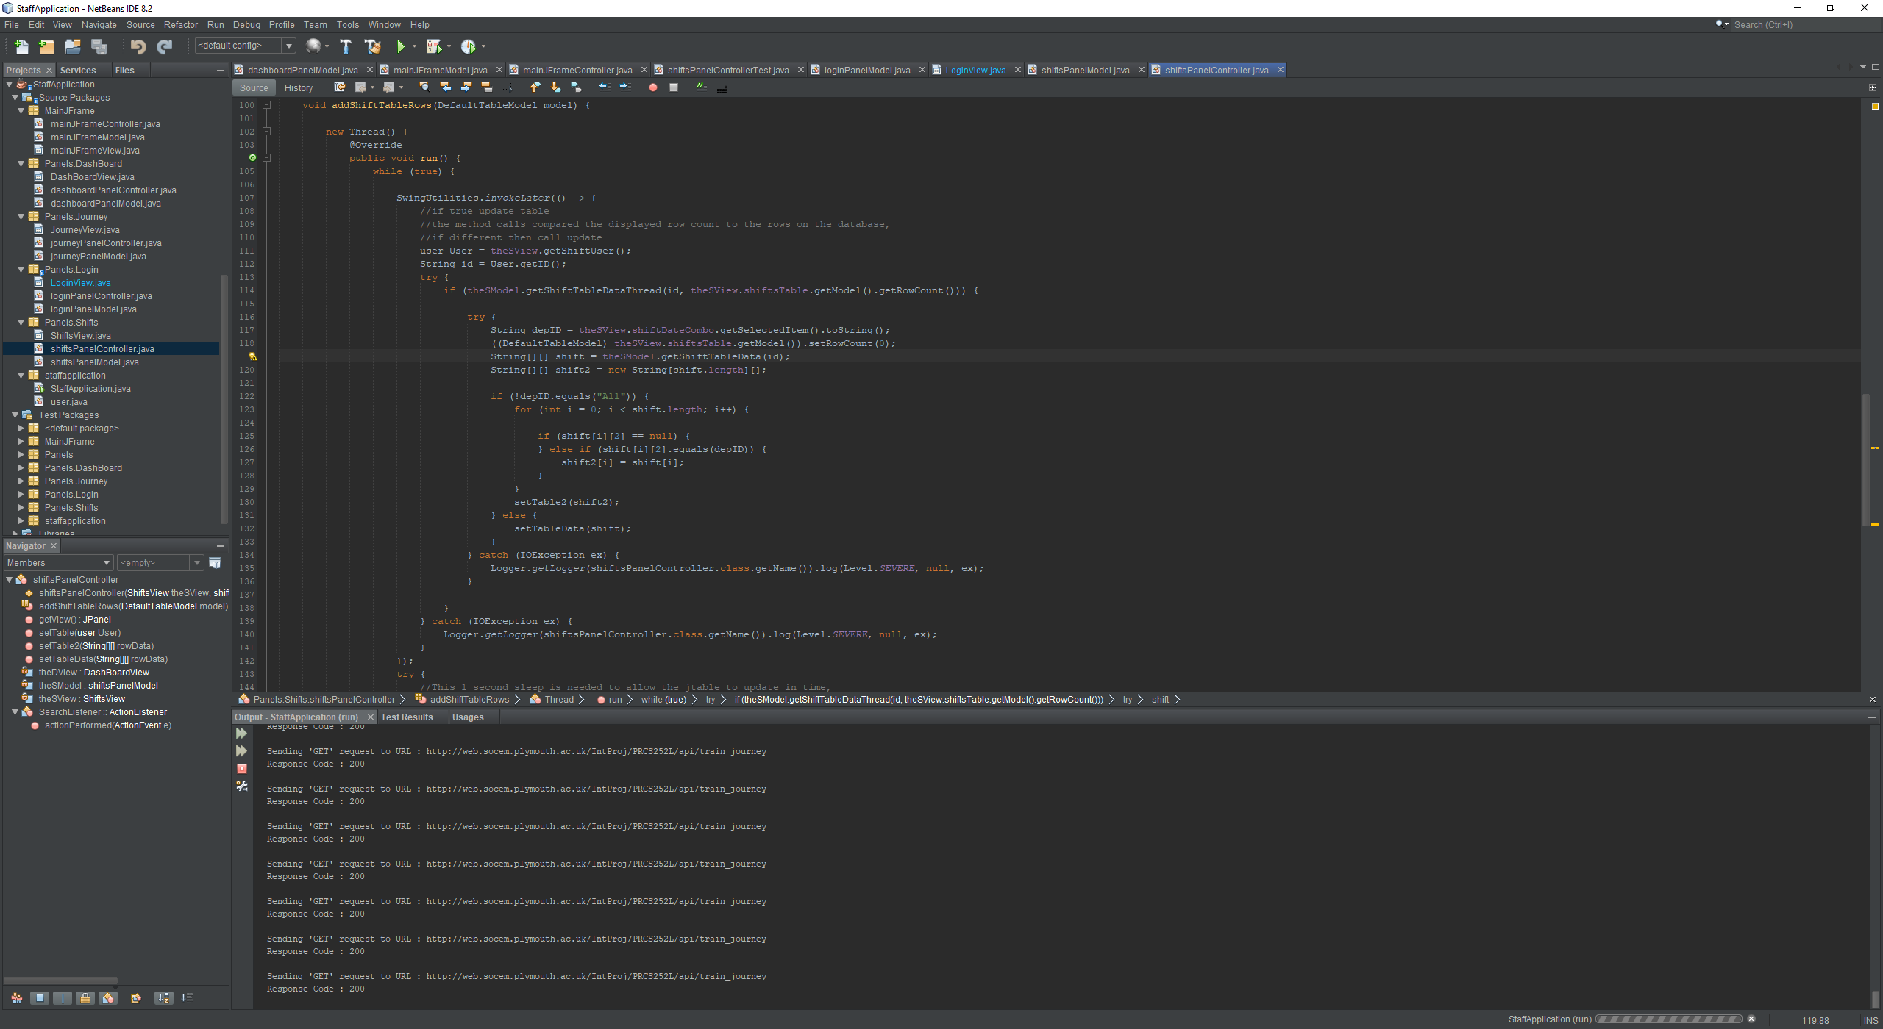
Technical Details
The application is developed with the MVC style.
This means that the view, logic and data is broken into different areas and also allows the models to be used independently.
This was an effective route, as it allowed the overview page to directly call the two table models instead of rerunning the same code in a separate model.
Threading within the models constantly checks to see if there as been an update to the database, and pushes the update within seconds to all relevant tables.

Slide 30
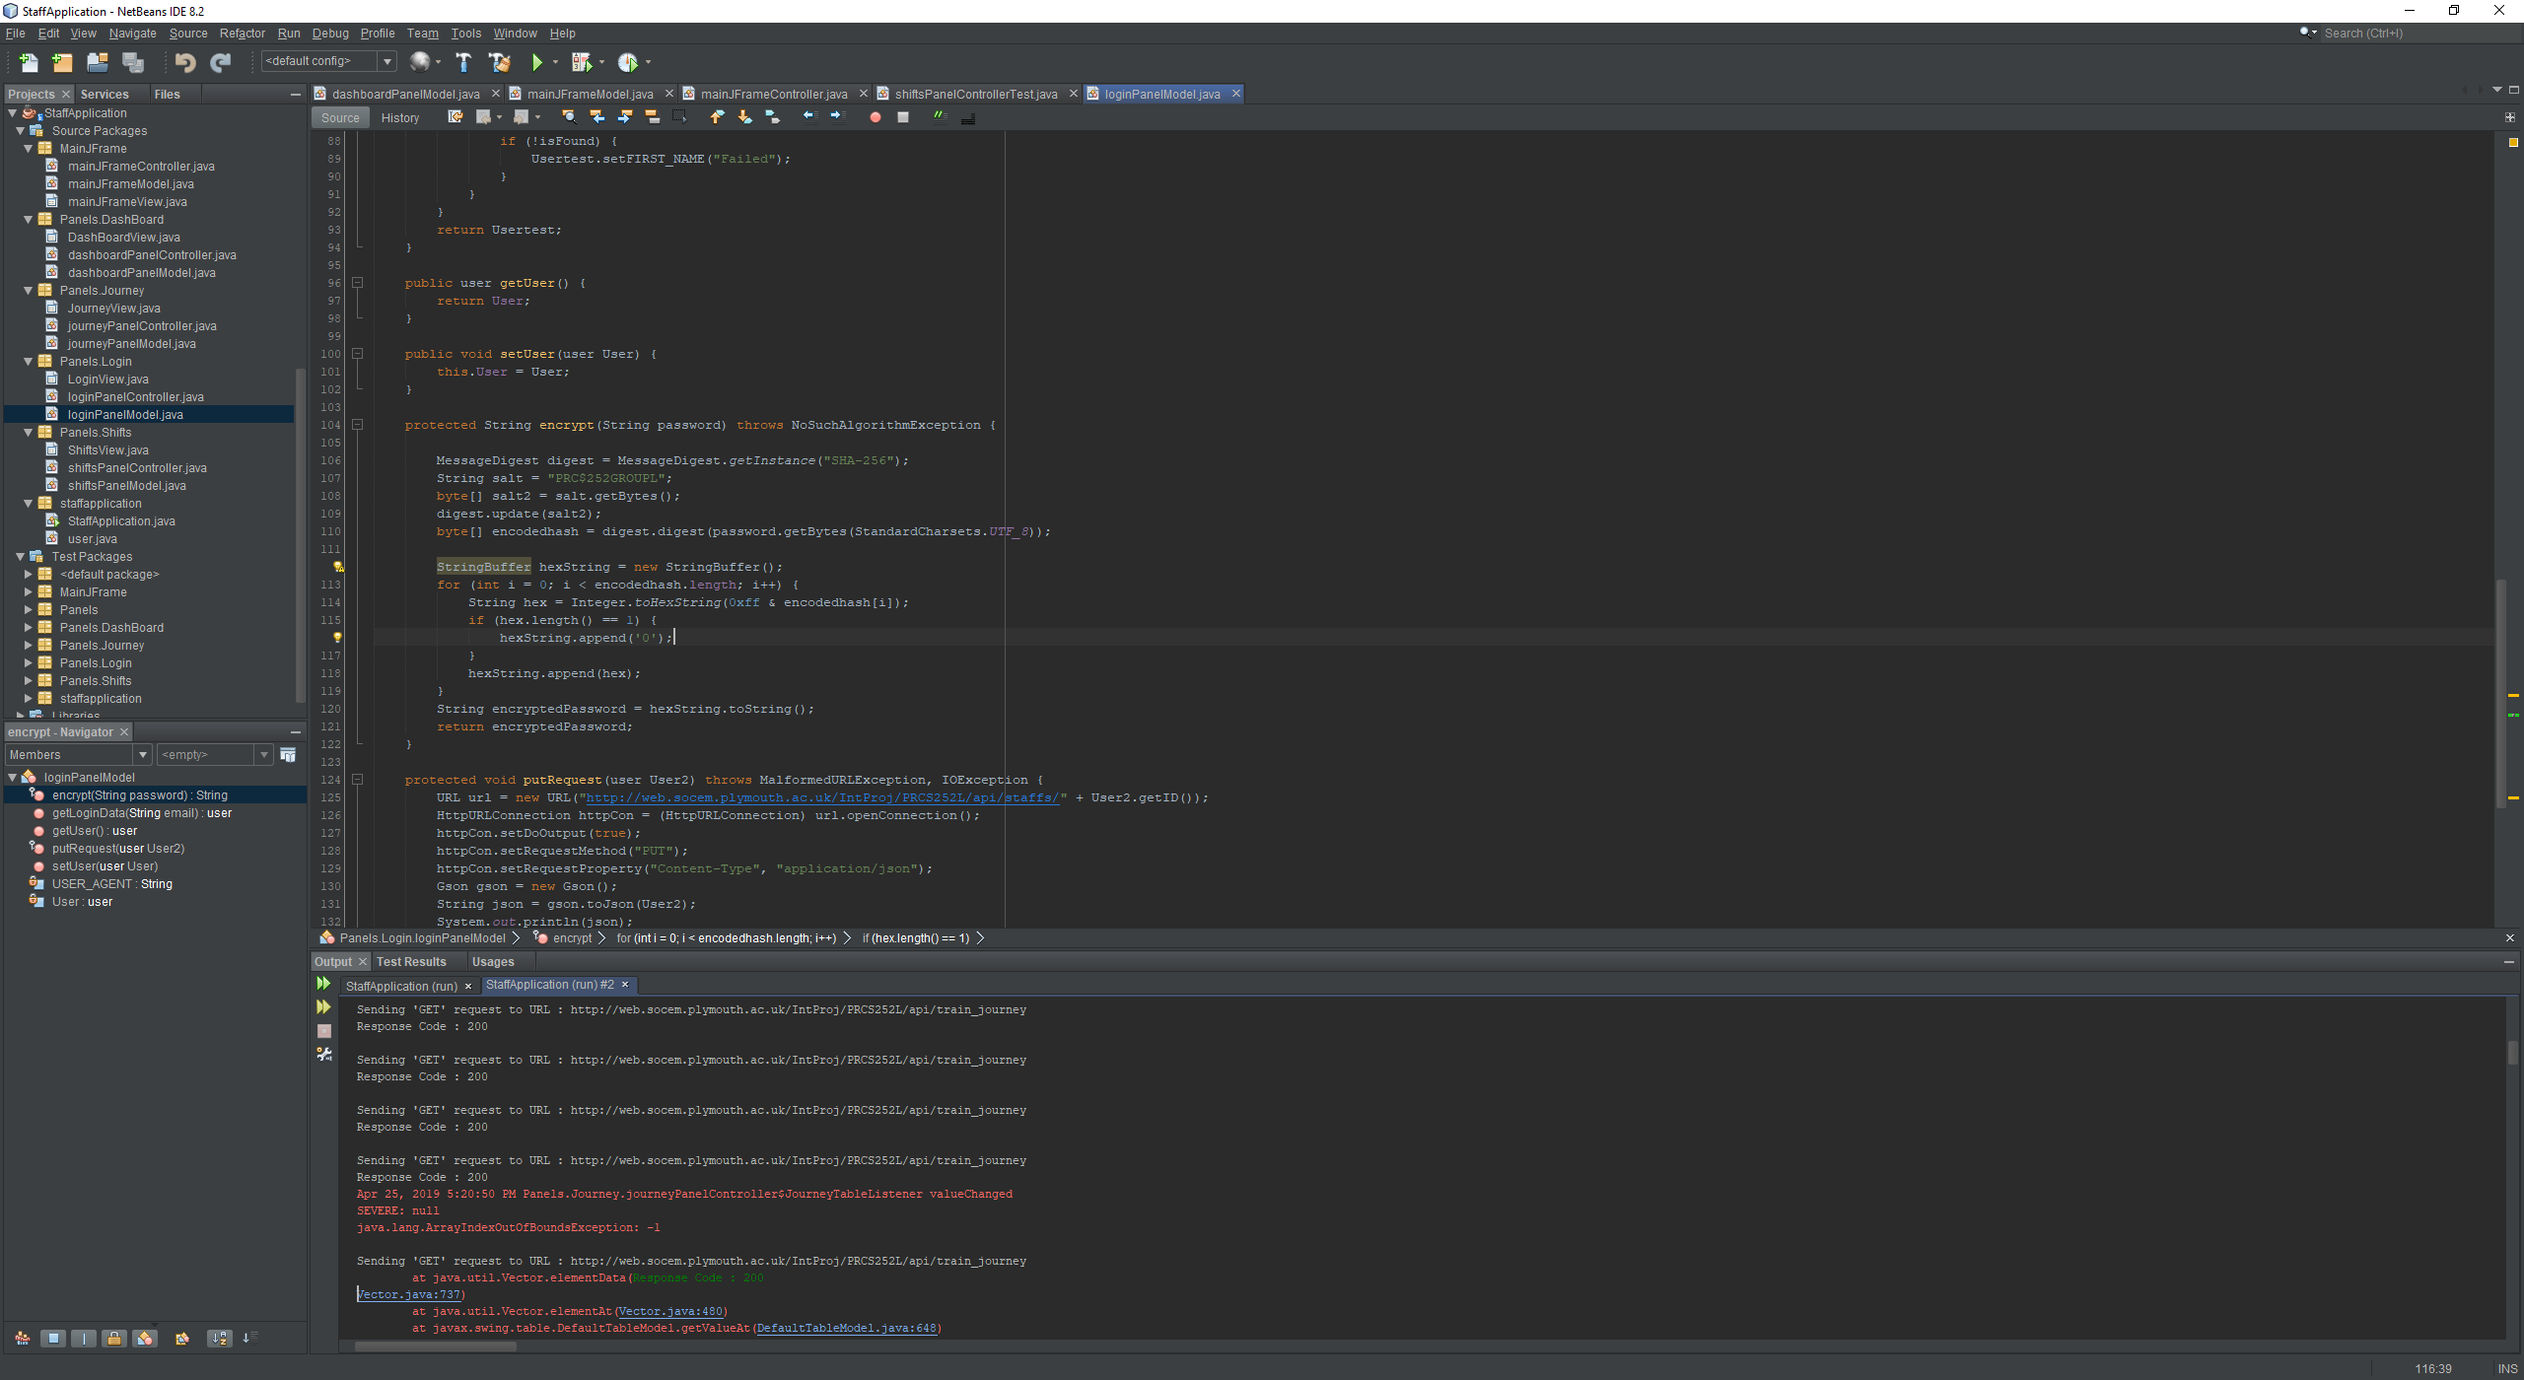
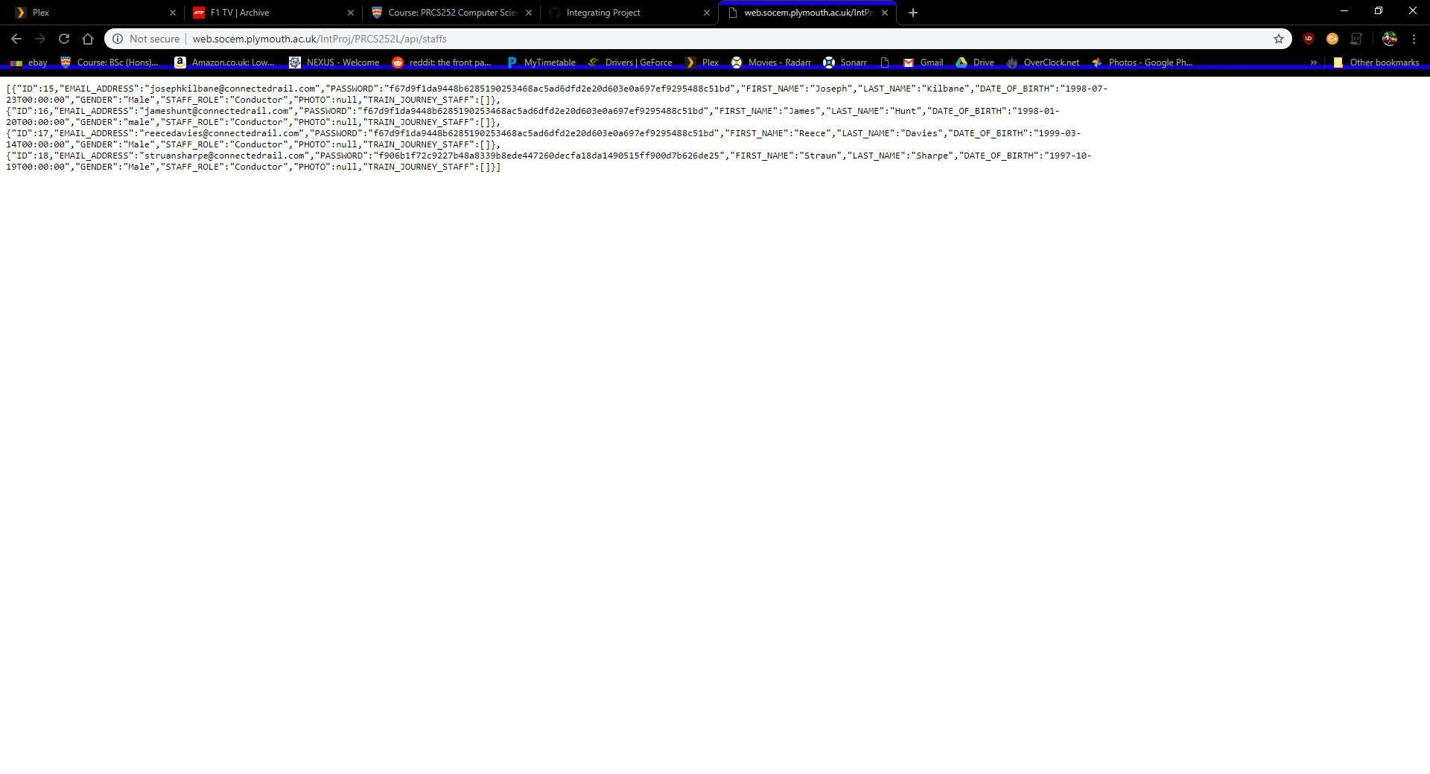
Security
In this project, we decided to all use SHA-256 and the salt of PRC$252GROUPL to salt and hash the passwords.

Slide 31
Mobile Application
Developed By Reece Davies and Struan Sharpe

Slide 32
Summary of mobile app
Allows the customer to sign in and out of their account, using their email address and password.
Allows the customers to search for a specific train journey, with train stations and times as parameters.
Customers are able to purchase a ticket for their journey (payment not fully implemented).
Allows customer to view their active and expired tickets.
Securely implemented with sessions, with hashing.

Slide 33
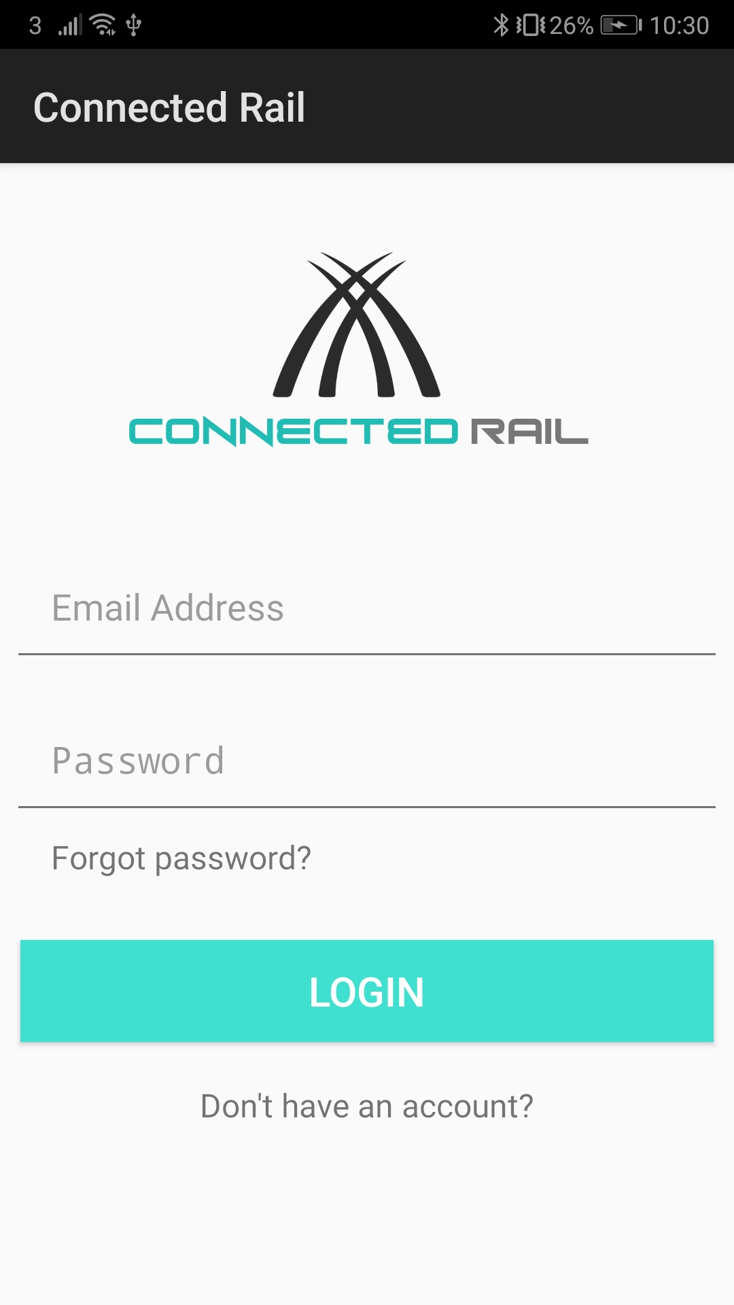
Log into account

Slide 34
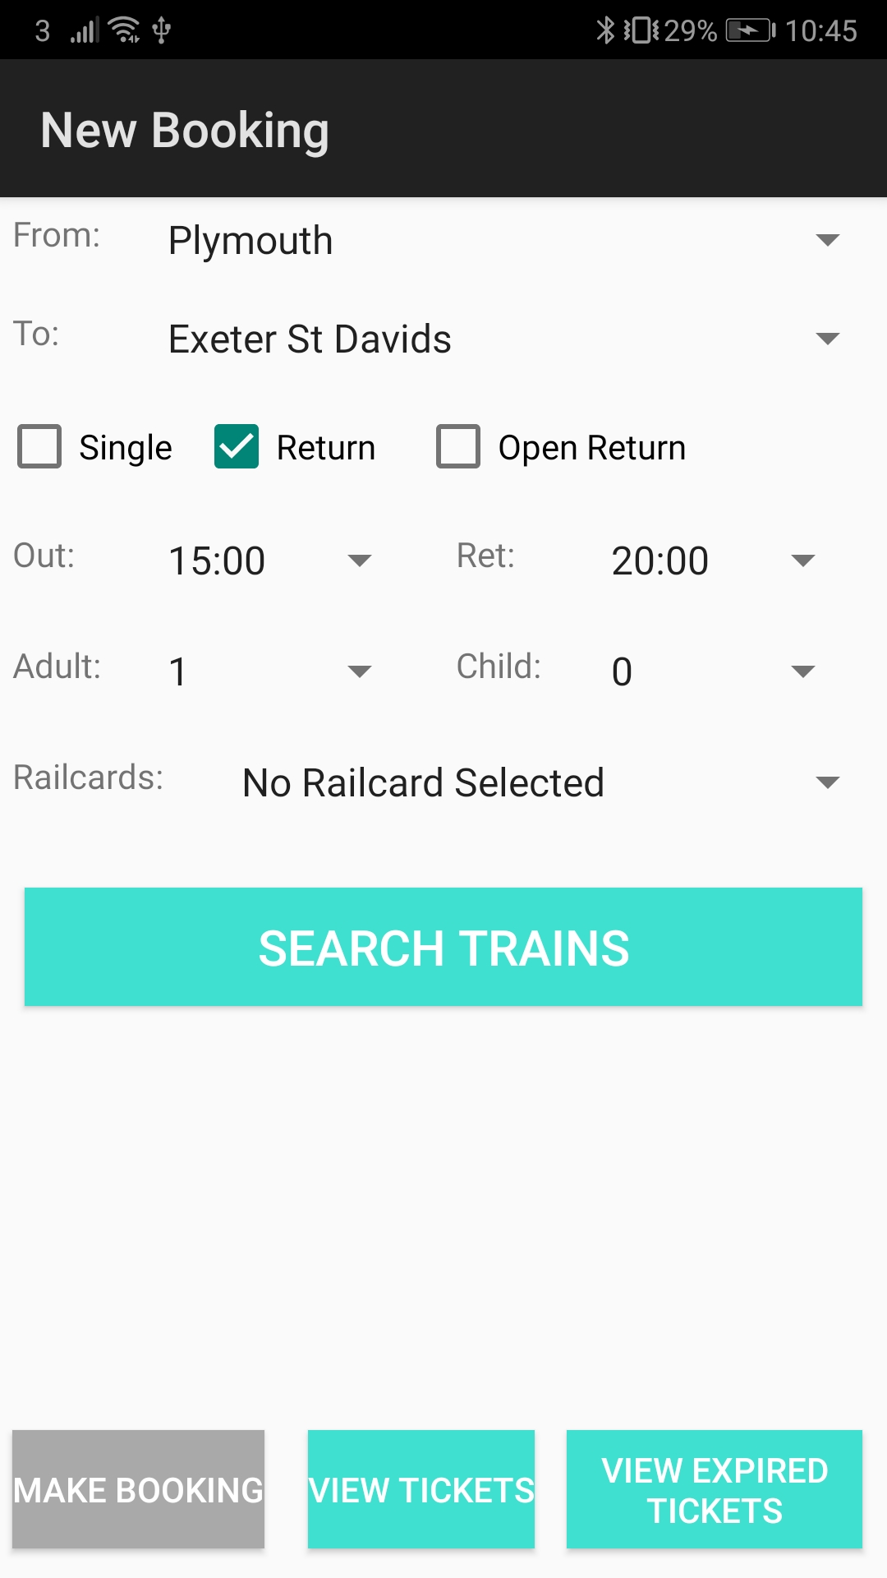
Search for available trains

Slide 35
Pay for ticket

Slide 36
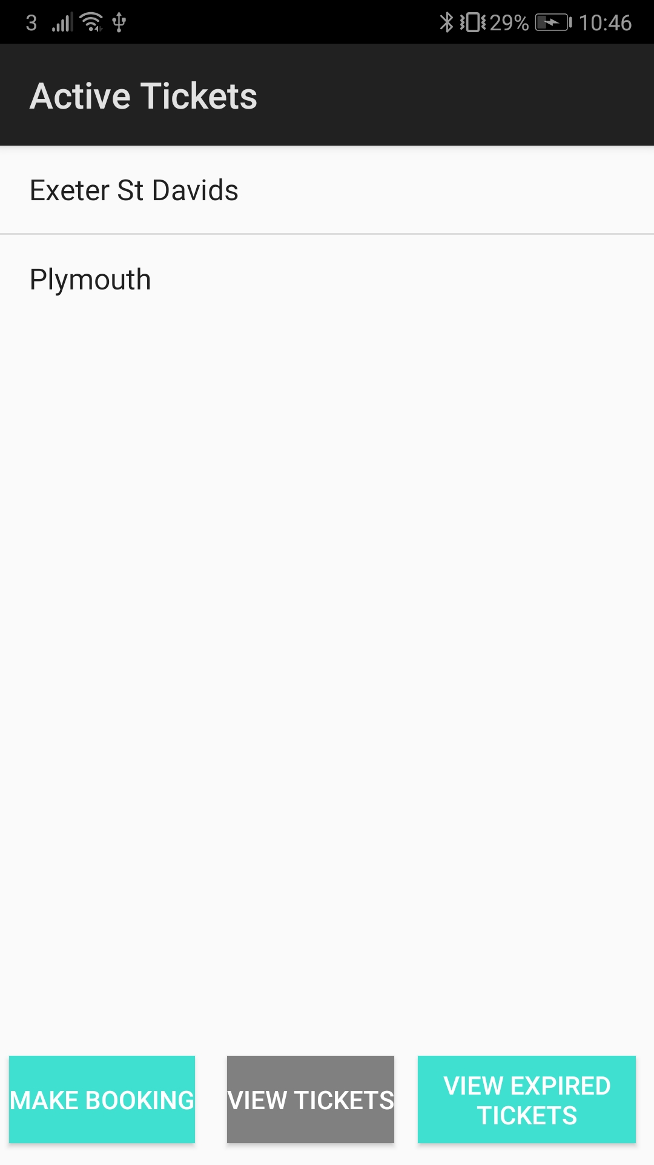
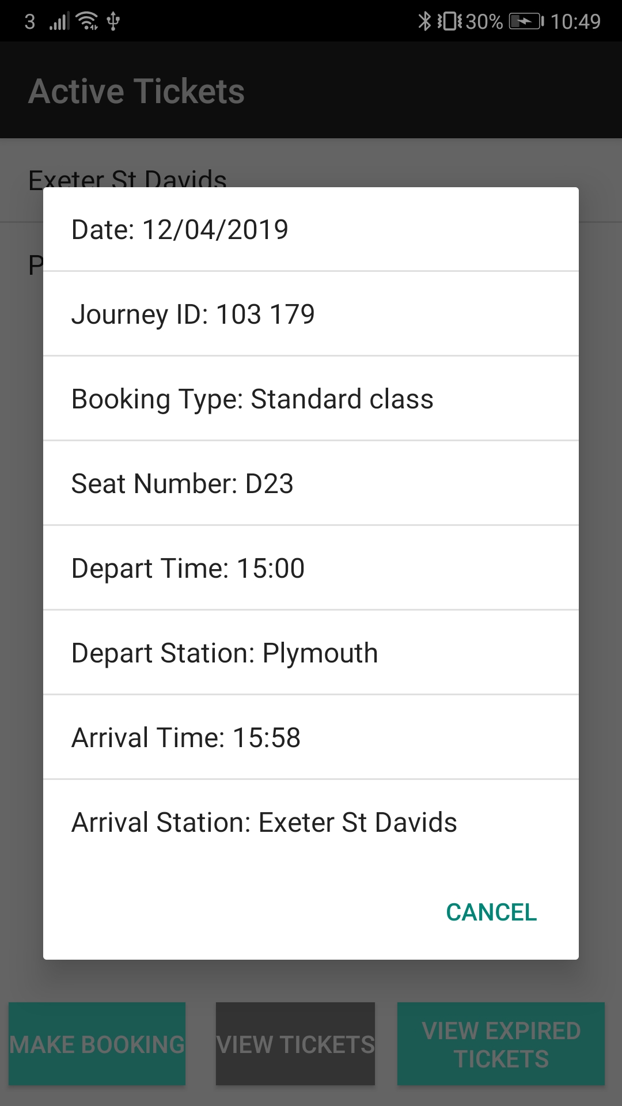
View Active Tickets

Slide 37
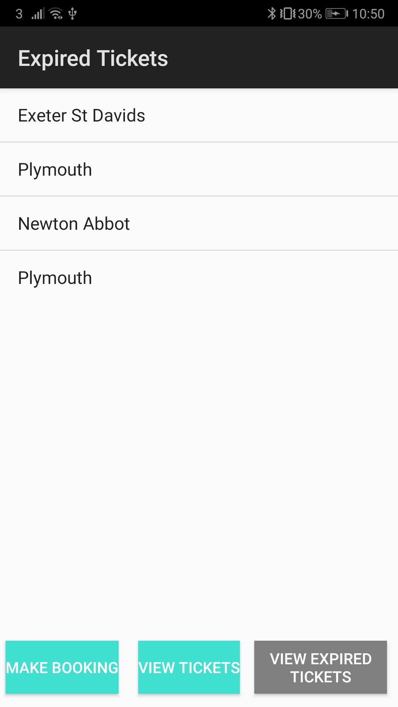
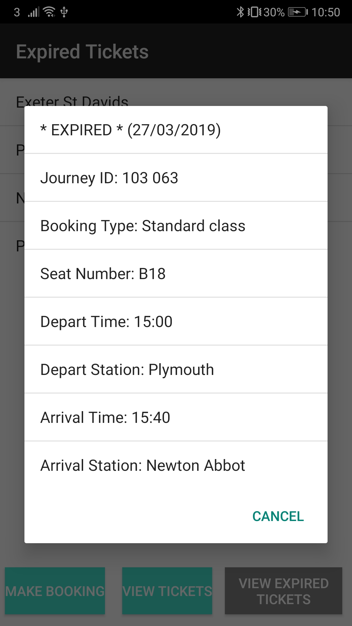
View Expired Tickets

Slide 38

Questions?

